Slide 4
Notes:
It is a multilanguage campaign, each with a context, culturally relevant and adaptable to local context. The pencil is a universal symbol and carries the message that education is not from a tablet. It requires the human touch, the guidance of the hand of a teacher.

Slide 5
Go Public! Fund Education
Is a global campaign to mobilize more funding for public education.
The campaign is driven by education unions organizing as the voice of teachers and education workers.

Slide 6
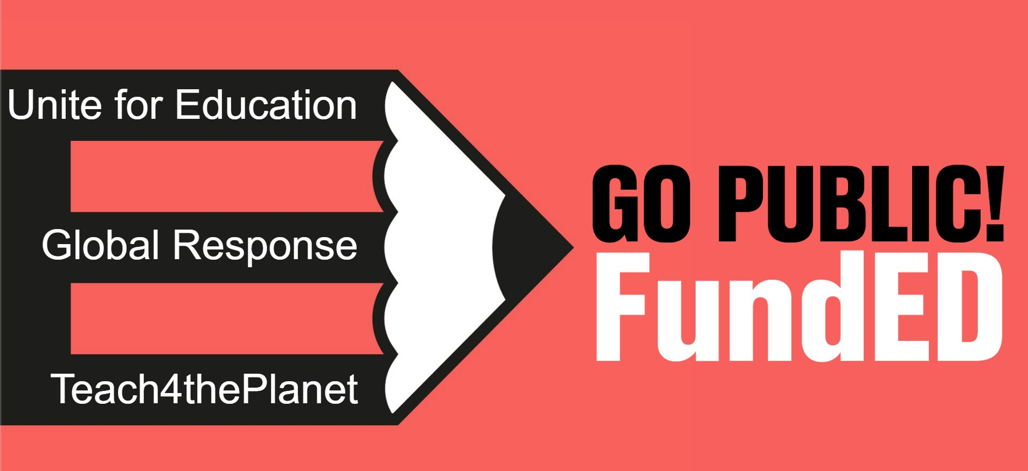
Notes:
This campaign builds on the experience and successes of previous EI campaigns. It represents our 30 years advocating for our profession and for quality education as a human right and a public good.

Slide 7
Go Public! Building blocks
The Go Public! Fund Education Campaign was approved by the elected leaders of Education International as a response to the call from EI’s 8th World Congress Resolutions.
The officers of Education International and the Executive Board have endorsed the campaign and called on EI members to participate.
The campaign is the result of an inclusive process welcoming the diverse voices within EI and extensive consultations at all levels.
Notes:
The campaign as it is today, is the result of a democratic, inclusive process. It has a mandate, and the backing of EI's elected leaders, it comes from members for members.

Slide 8
Go Public! Fund Education
Funding public education systems improves pay and working conditions and empowers teachers and education support personnel to stay and thrive in the profession they love.
It inspires a new generation to join the professions the world desperately needs.
The Go Public! Fund Education campaign contends that there is sufficient funding for sustainable investment in education and in educators to achieve quality education for all.
Notes:
Follow the money! There is not a lack of resources to fund public education, but a lack of political will to make education the priority the world needs. We need to ensure that public financing is directed to where it is needed most – ensuring that every student has a professionally-trained, qualified, and well-supported teacher, in a quality learning environment.
Military spending, fossil fuel subsidies, tax evasion, international debt payments, are some examples of priorities which are deviating resources from education.

Slide 9
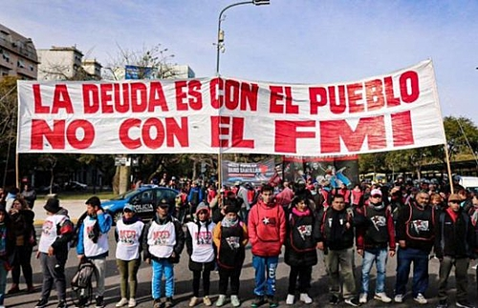
Follow the money: Debt
Many countries are spending more on debt servicing than they do on education and health.
Some countries spend the equivalent of over half of their total budget for health and education just on repaying their debts.
Bangladesh and Ghana would each have had over $5 billion to invest in public services every year and Kenya would have had over $4 billion a year in extra revenue.
This Photo by Unknown Author is licensed under CC BY-ND
Notes:
Action aid 2020
Follow the money! There is not a lack of resources to fund public education, but a lack of political will to make education the priority the world needs. We need to ensure that public financing is directed to where it is needed most – ensuring that every student has a professionally-trained, qualified, and well-supported teacher, in a quality learning environment.
Military spending, fossil fuel subsidies, tax evasion, international debt payments, are some examples of priorities which are deviating resources from education.

Slide 10
Fund education not War
Total global military expenditure increased by 3.7 per cent in real terms in 2022, to reach a new high of $2240 billion.
Military expenditure in Europe saw its steepest year-on-year increase in at least 30 years, according to the Stockholm International Peace Research Institute.
This Photo by Unknown Author is licensed under CC BY
Notes:
Follow the money! There is not a lack of resources to fund public education, but a lack of political will to make education the priority the world needs. We need to ensure that public financing is directed to where it is needed most – ensuring that every student has a professionally-trained, qualified, and well-supported teacher, in a quality learning environment.
Military spending, fossil fuel subsidies, tax evasion, international debt payments, are some examples of priorities which are deviating resources from education.

Slide 11
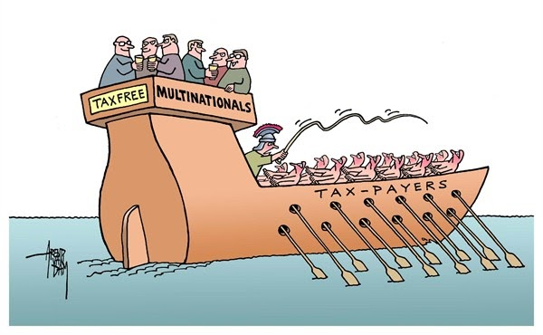
Follow the money: Tax abuse
Governments around the world are losing nearly:
A. $100 billion in tax revenue per year
B. $500 billion per year
C. $350 billion per year
This Photo by Unknown Author is licensed under CC BY-SA
Notes:
Action aid 2020
Follow the money! There is not a lack of resources to fund public education, but a lack of political will to make education the priority the world needs. We need to ensure that public financing is directed to where it is needed most – ensuring that every student has a professionally-trained, qualified, and well-supported teacher, in a quality learning environment.
Military spending, fossil fuel subsidies, tax evasion, international debt payments, are some examples of priorities which are deviating resources from education.

Slide 12
📢 Go Public! Fund Education
Education International’s new global campaign Go Public! Fund Education is an urgent call for governments to fully fund public education systems and invest in teachers.
The campaign will support education unions to build well-resourced equitable public education systems that empower, respect, and value teachers and education support personnel.

Slide 13
GOALS

Slide 14
Strengthen the narrative for well-resourced inclusive and equitable quality public education systems and their indispensable role in advancing human rights, equity and equality, peace, democracy, and climate justice.

Slide 15
Expose the negative impact of austerity and privatization on the quality and equity of education systems and the rights and conditions of education workers.
Notes:
A key strategy in changing the narrative for public education is
to expose the negative impact of austerity on the quality and equity of
education systems through data and strategic research. The campaign makes the
link to demonstrate how privatization and commercialization of education has a
negative impact on education, students, and educators.
In particular there will be a focus to expose the negative impact of EdTech privatization on teachers and students, and how unions can advocate for the rights of their members in a post-covid reality. The lessons of Covid are clear and will be articulated by the campaign: Privatization fails students, fails educators, fails learning communities, it fails across imperatives. It’s always about profit, not about education.

Slide 16
Provide targeted support for EI member organisations to advocate for increased public investment in education systems and education workers at the national, regional and global level.

Slide 17
How can you engage with the campaign?
Use the campaign toolkit (EI website)
Publish and share campaign information on your platforms
Produce campaign materials and bring them to events and protests (toolkit available)
Work with colleagues to adapt the campaign to your context.
Form alliances with organizations in your community including student groups, parents, unionists and social justice activists.
Organize discussions, forums in your schools and education communities around education funding and priorities in your context.
Notes:
Not sure if we want someone else to be the contact.

Slide 18
Notes:
Campaign launch on the International Day of Education. Mugwena along with Susan led us as we launched the campaign joined by affiliates around the world, and also the African Women's Network who was meeting on the same day.

Slide 19
Notes:
Examples: The NEU is demanding a fully funded, above-inflation pay rise for teachers and support staff, and effective action on pay for supply and other educators.

Slide 20
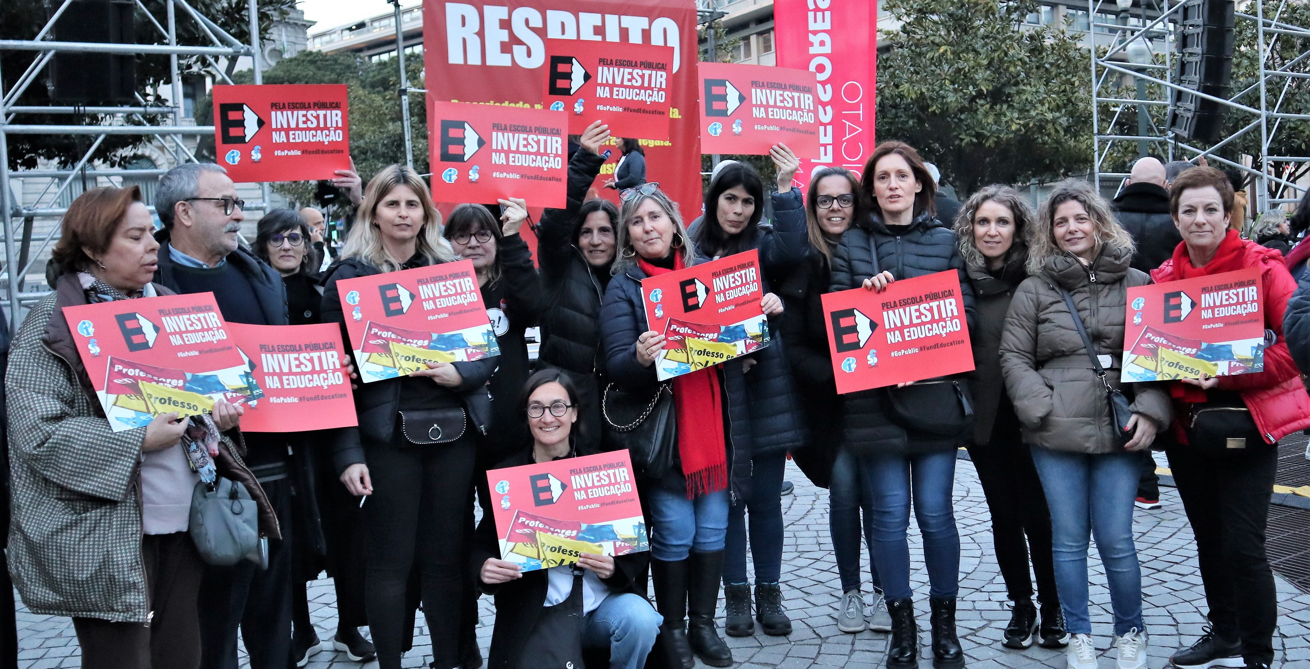
Notes:
In Portugal our members marched with the campaign messages during a recent strike.

Slide 21
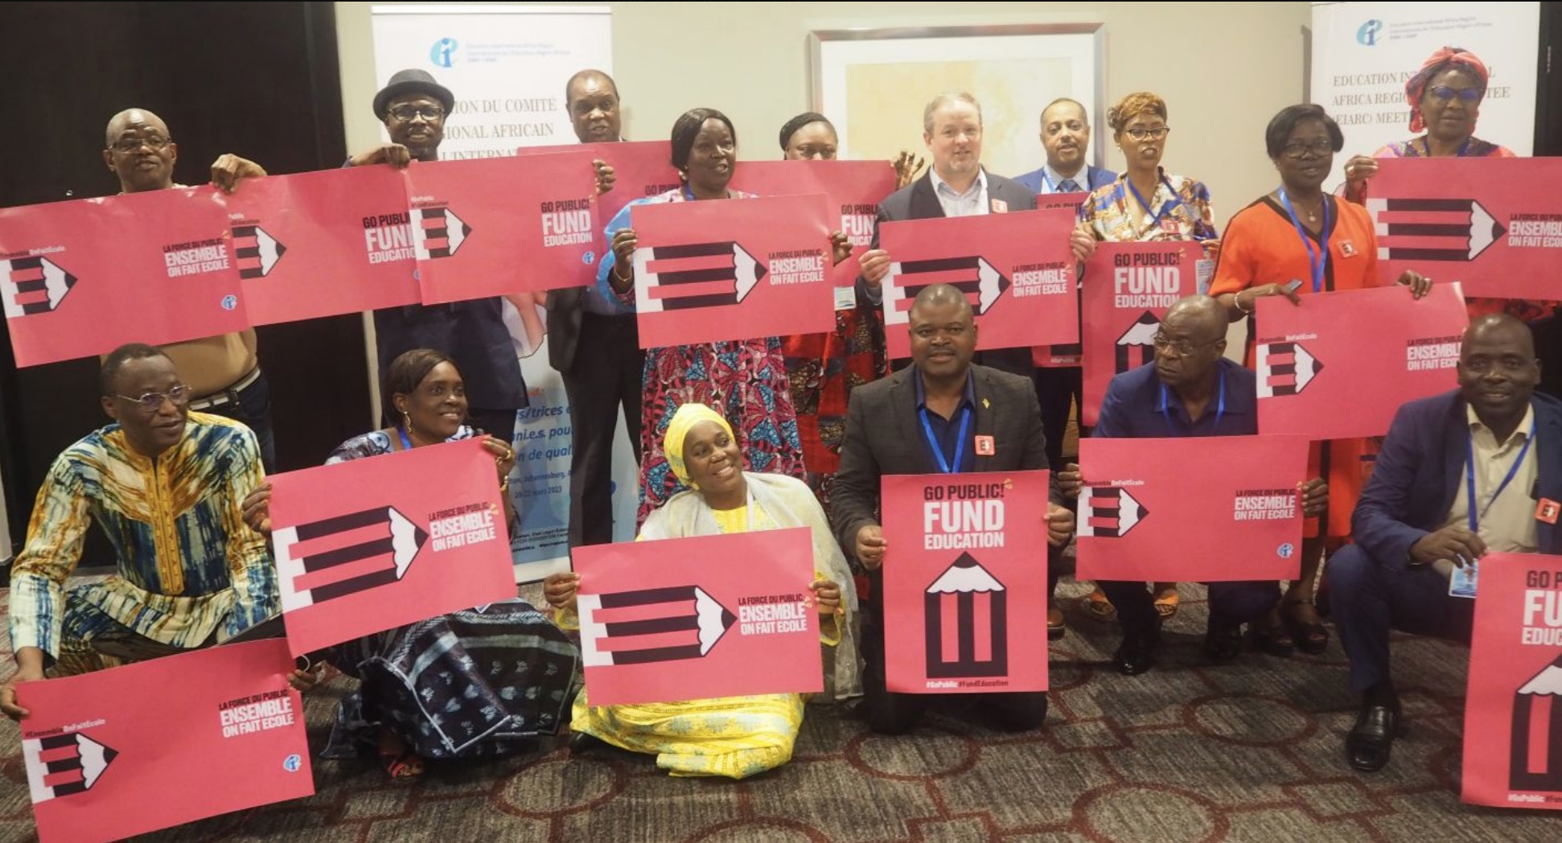
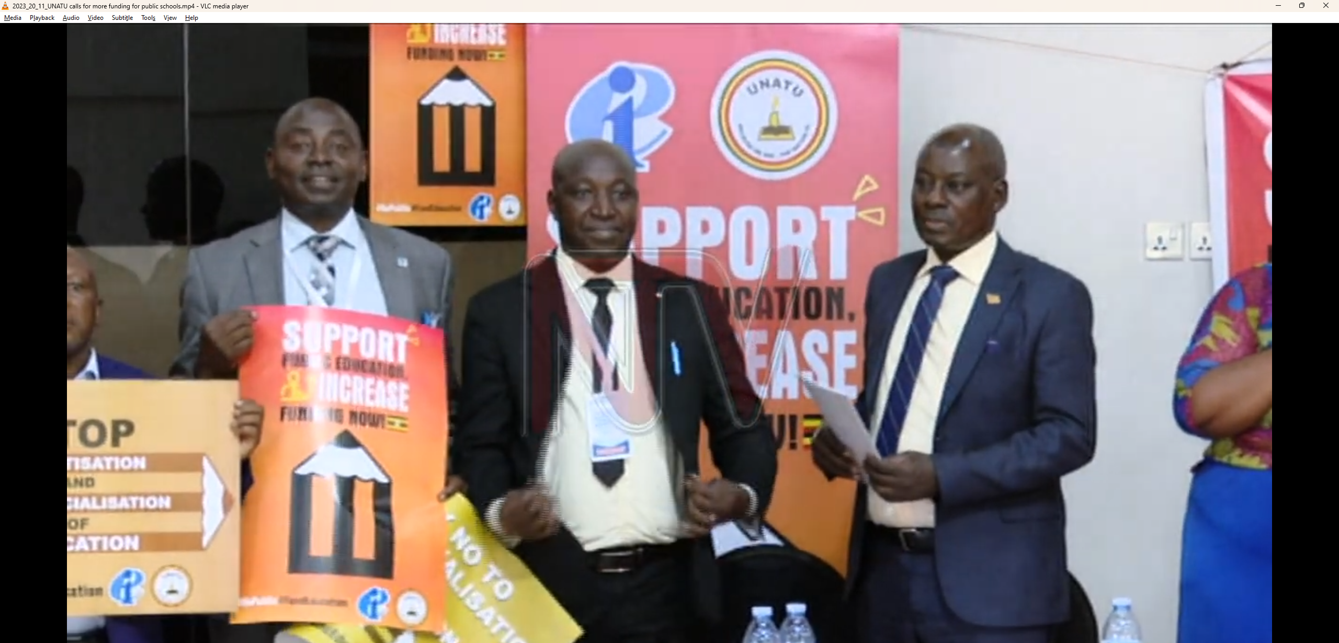
Notes:
Uganda launch.

Slide 22
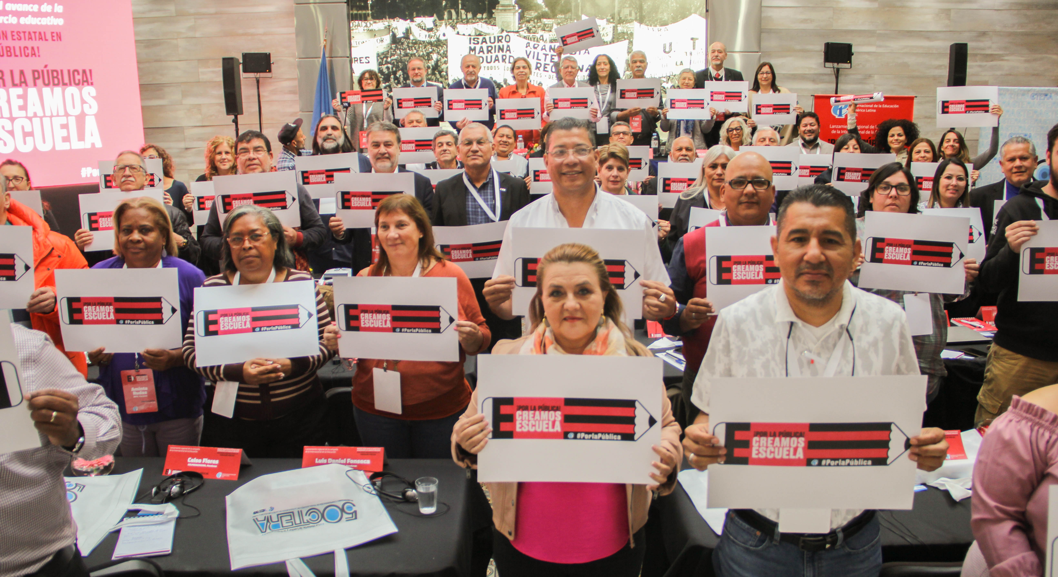
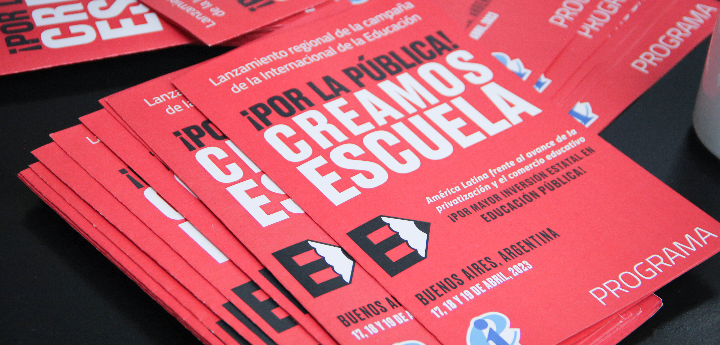
Notes:
Uganda launch.

Slide 23
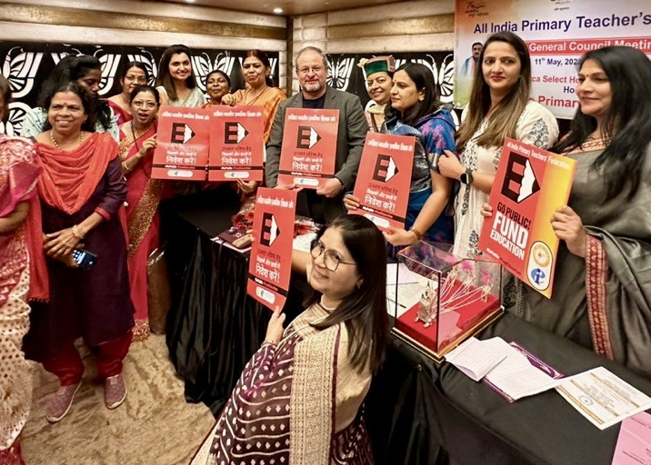
Notes:
Launch in Kenya as unions say no to privatization.

Slide 24
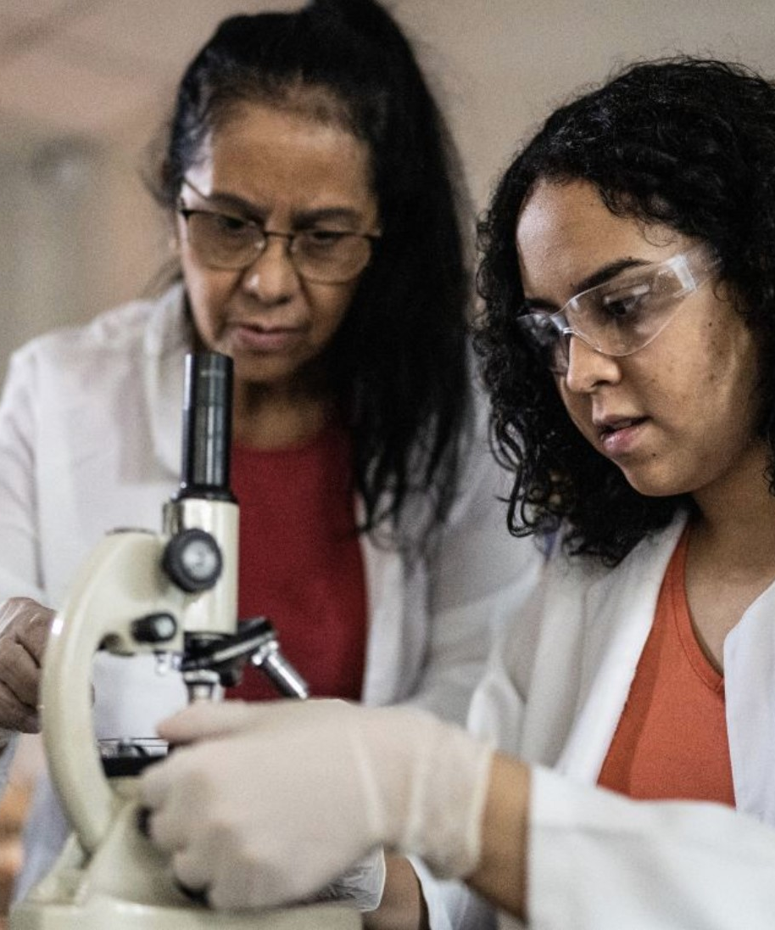
This is our Narrative
We as teachers and education personnel are the heart, we are the builders, the creators of school, of education communities.
We deserve the respect, authority, the dignity and pay our professions merits. We have the knowledge, the experience, and authority to guide our students, to create a more just and inclusive future.

Slide 25
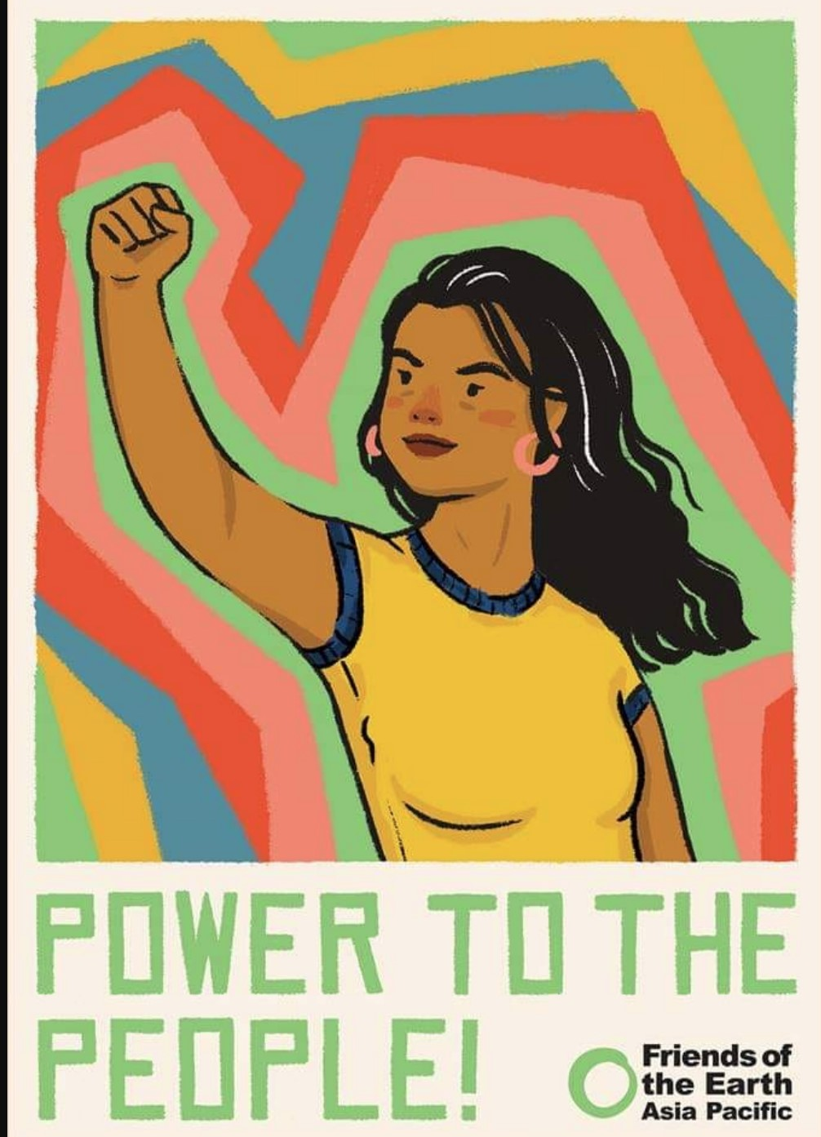
This is our Narrative
We are part of a movement. We believe in the public, we believe education is a human right and a public good.
We resist privatization, corporate greed, and the profiteers who want to pillage our common resources and use our children to make money for their private interests.
Notes:
Wages that fall

Slide 26
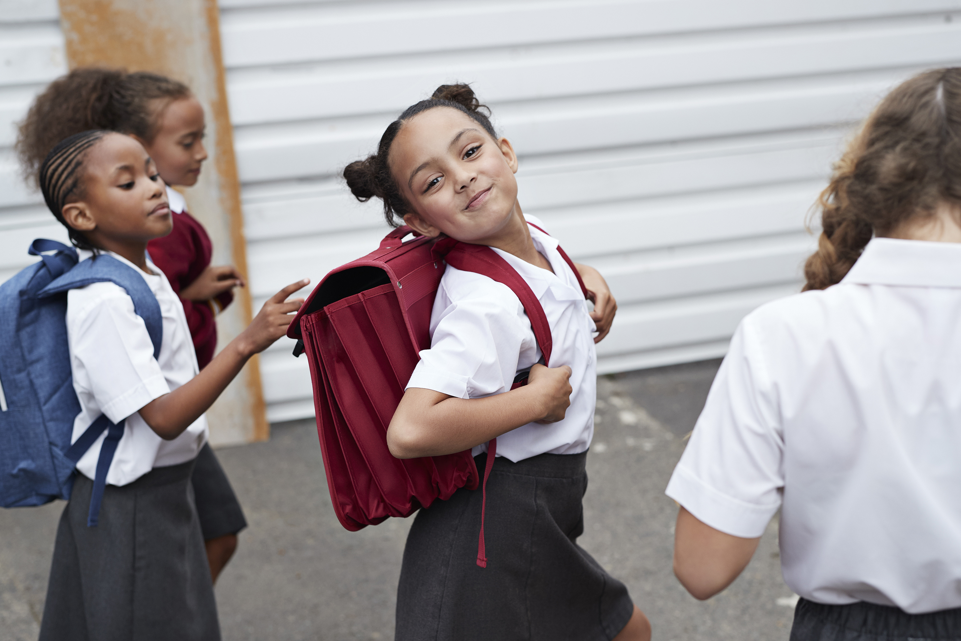
This is our Narrative
We believe that fully funding public education systems, and the education personnel, is the key to a sustainable future for all.

Slide 27
gopublic.ei-ie.org
onfaitecole.ei-ie.org
porlapublica.ei-ie.org
Edit text

